Slide 1
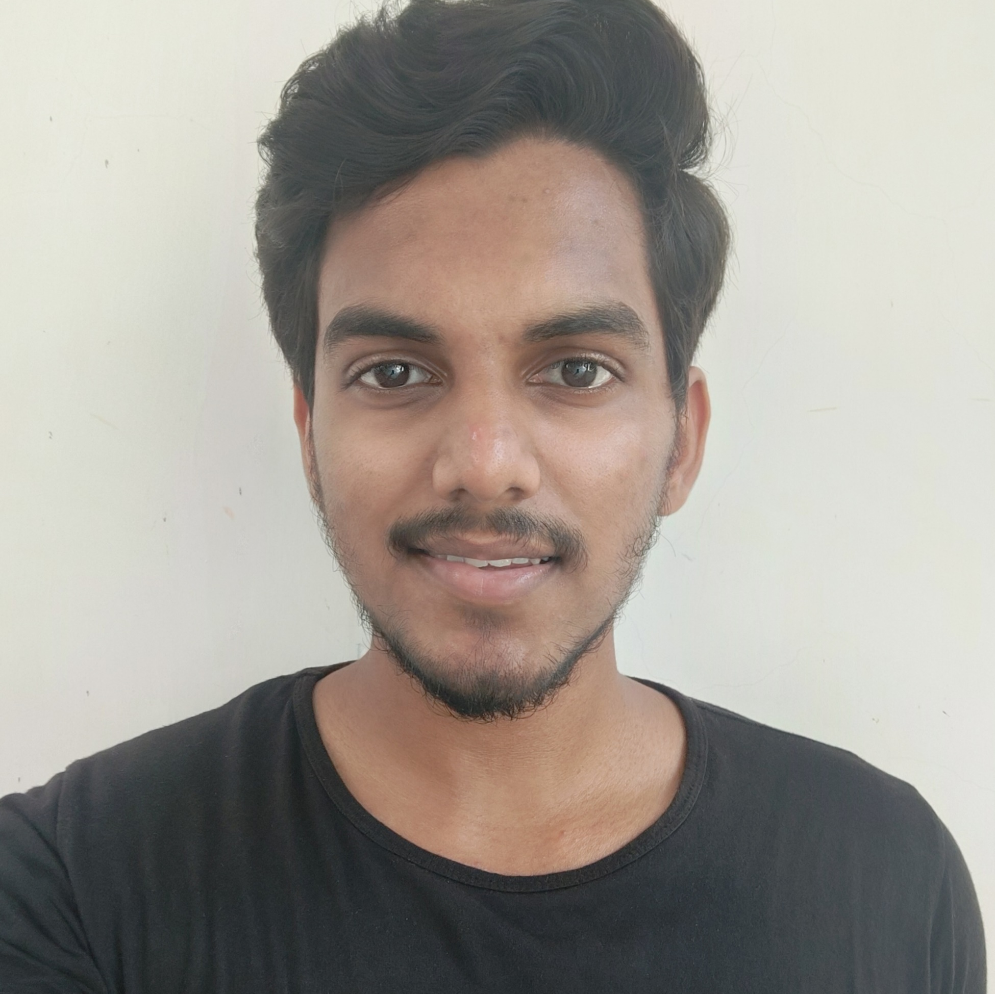

SRIHARSHA SURABATHULA
Bachelor of Engineering
Electronics and communication Engineering : 2018 - 2022
Analyst/Software Engineer
Skills
Bangalore
Java 8 /J2EE | Java Basics, OOPS, Generics, Collections, Arrays, Loops, Lambda Exp, Stream API Junit, Mockito, Servlets
Spring core | IOC & Dependency Injection, Autowire
Spring REST | REST controllers, Implementation of GET, POST, PUT & DELETE, Bean Validation & Exception Handling, Testing Services, Controller & Repository layer
Spring Data JPA | Implement DAO layer using spring Data repositories, Transaction Management
Spring Boot Microservices | Spring Boot Starters, annotations, Messaging Service, Sync/Async comms, Swagger API documents
Spring Cloud | Eureka, Netflix Hystrix andConfig Server
React | Components, Hooks, Event handling, Redux, Reducers, Testing using Jasmin & Karma
Database | MongoDB Basics ,
UI Tech | HTML 5 & CSS 3,JavaScript, ES6 & TypeScript Reusable templates, Optimized UI Designed
Tools | Git, Postman, Maven, IDE
Add On skills | Communications, Team management.
sriharsha9290840@gmail.com
7731926281
A4
Full Stack Developer
Hands on experience in creating microservices with Spring boot, Spring Security, Spring Cloud API Gateway, Eureka server,, load balancing.
Experience in creating documentation with Java docs and swagger and in unit testing using Junit, Mockito.
Hands on experience in building web pages using Html, Css, Bootstrap and working knowledge on ReactJS with react hooks , reactive forms , routing and Material UI.
Development experience using Springtoolsuite , VS Code , postman API connection and Mongodb Atlas.
Deals and coupons finder app
Completed end to end case study of deals and coupons Application along with Swagger documentation and testing using junit and mockito and react js is used for user interface MongoDB Atlas as Online Database.
Employee Management System
Developed backend application using Monolithic Architecture and implemented all the CRUD operations using Spring Boot, Postman and ReactJs for User interface

